Slide 1
COSC 2430
Fall 2019
Lab session 2

Slide 2
How to submit homework:
Download Winscp (windows) or FileZilla (Mac) and install it
Run the program
Use your credentials to connect to the Linux server
You have received your credentials from CS department via email
Host name is: program.cs.uh.edu and your username starts with cosc
When you logged in, you see two windows. One the left side you see your files on your personal machine and on the right side you see the Linux server

Slide 3
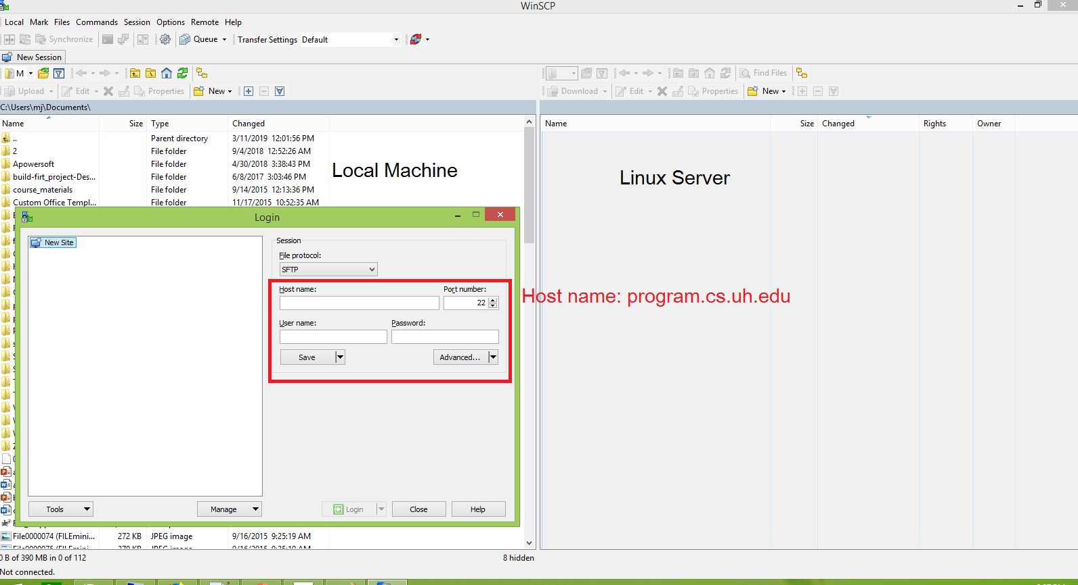
How to submit homework:

Slide 4
How to submit homework:
Create a directory in Linux (in the current path )
mkdir hw1
makes directory named as hw1
Upload your Java files using Winscp / Filezilla to the server
select the files from left window (your machine) and drag them to the right window where hw1 directory is located
All the files must be in hw1 directory

Slide 5
How to Run your homework on Linux [Recommended]:
Run your homework using shell scripts files (compile_java.sh & test_java.sh)
Login to the server using ssh
Windows 10: open cmd, Mac/Linux : open Terminal
Type ssh coscXXXX@program.cs.uh.edu
coscXXXX is your username
Enter your password
Windows 8/older : use Putty to connect with ssh
Go to the hw1 directory using ch command ( change directory)
cd hw1
Download test cases and sh files from homework page (data.zip + compile_java.sh + test_java.sh) and
Unzip data.zip and upload java files, sh files and tiny*.txt files to the server (all files must be in hw1 directory)
Compile HW1.java using compile_java.sh
sh compile_java.sh
It compiles the java file creates HW1.class if there is no error
You can check it using ls command (ls list all the files in current path)
Run the Java compiled file (class file) using test_java.sh
sh test_java.sh

Slide 6
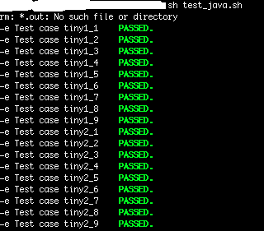
How to Run your homework on Linux:
If everything works fine you see an output like the below picture on your screen :
If you see some Fails on the screen, you should correct your program and look at the test cases where your program failed.

Slide 7
Linux Cheat Sheet:
Double click on this sheet to learn more about the Linux commands (File Commands section is recommended) and try some. It is fun ☺

Slide 8
How to Run your homework on Linux [Not Recommended]:
Run your homework using java
Login to the server using ssh
Windows 10: open cmd and type:
ssh username@program.cs.uh.edu
Enter your password
Go to the hw1 directory using ch command ( change directory)
cd hw1
Compile HW1.java using javac command
Javac HW1.java
It compiles the java file creates HW1.class if there is no error
You can check it using ls command (ls list all the files in current path)
Run the Java compiled file (class file) and specifies the arguments using java command
java HW1 input.txt output

